Slide 1
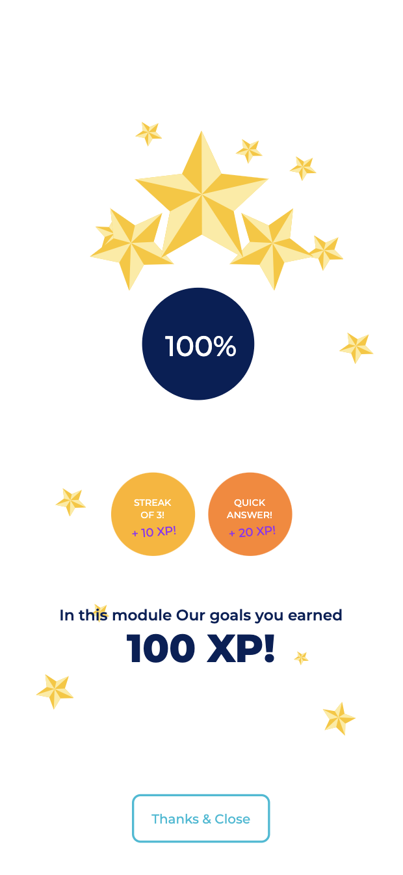
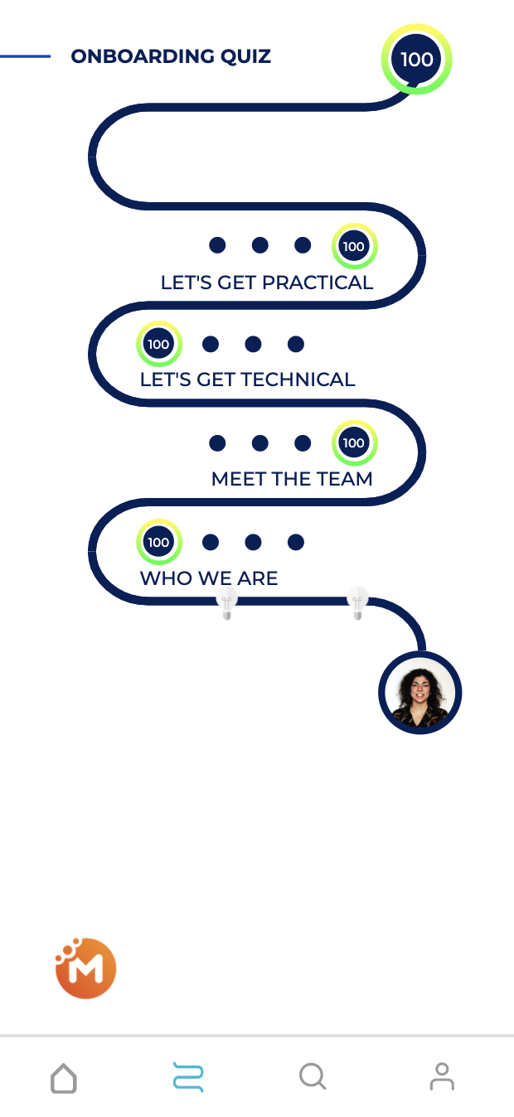
Starting with
MobieTrain
Notes:
Binnen 4 dagen wordt ons gloednieuwe leerplatform gelanceerd.
Hoe dit leerplatform er precies zal uit zien en hoe jullie hiermee aan de slag kunnen gaan, komen jullie dus heel snel te weten.
Belangrijk is dat, aan de hand van dit leerplatform, wij met zijn allen zullen kunnen werken aan het bijschaven van onze digitale kennis, onze skills, ….
En deze digitale kennis en skills heeft ieder van ons nodig om succesvol te zijn in zijn/haar job.
Meer hierover dus op het einde van deze week!

Slide 2
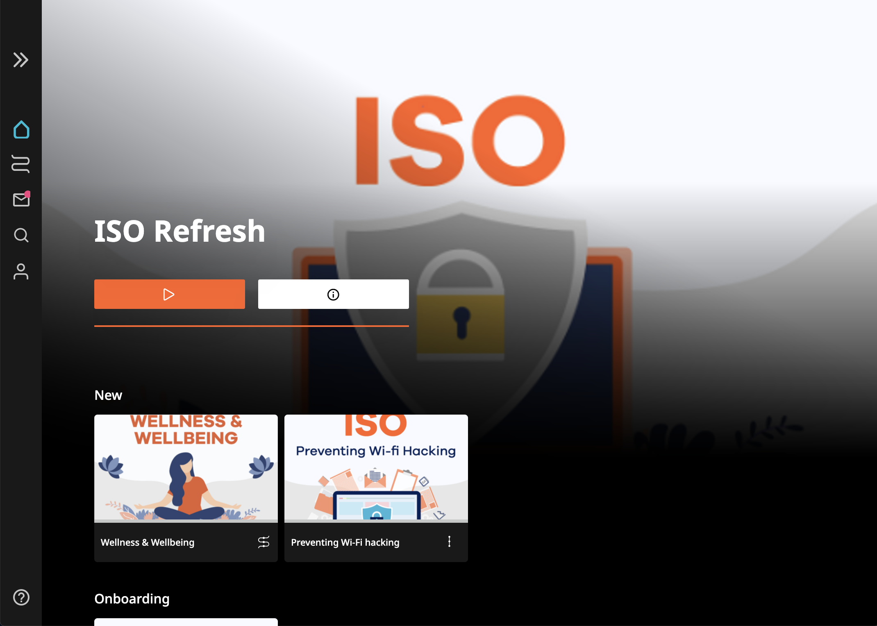
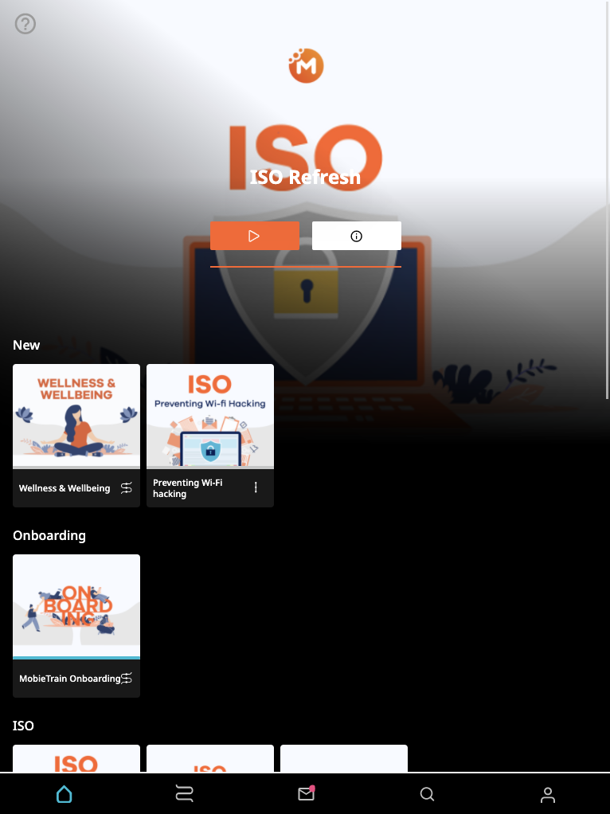
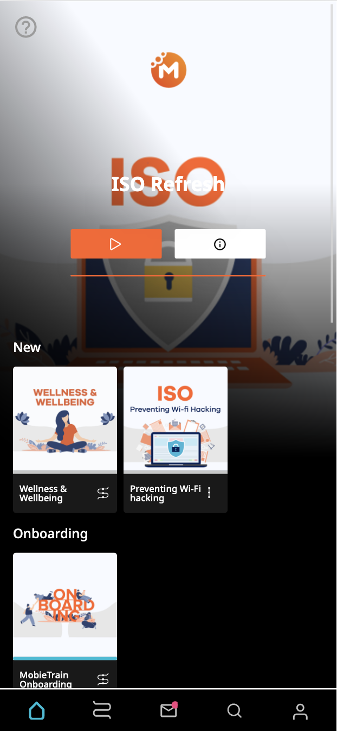
MobieTrain is a webapp with a mobile device approach.
That means that the webapp works with all type of devices with the supported browsers.
However, mobile phone devices offer a better user experience.
Supported browsers:
62+
16+
57+
11+
Notes:
What technology infrastructure is there available?
Are you working with a LMS system?

Slide 3
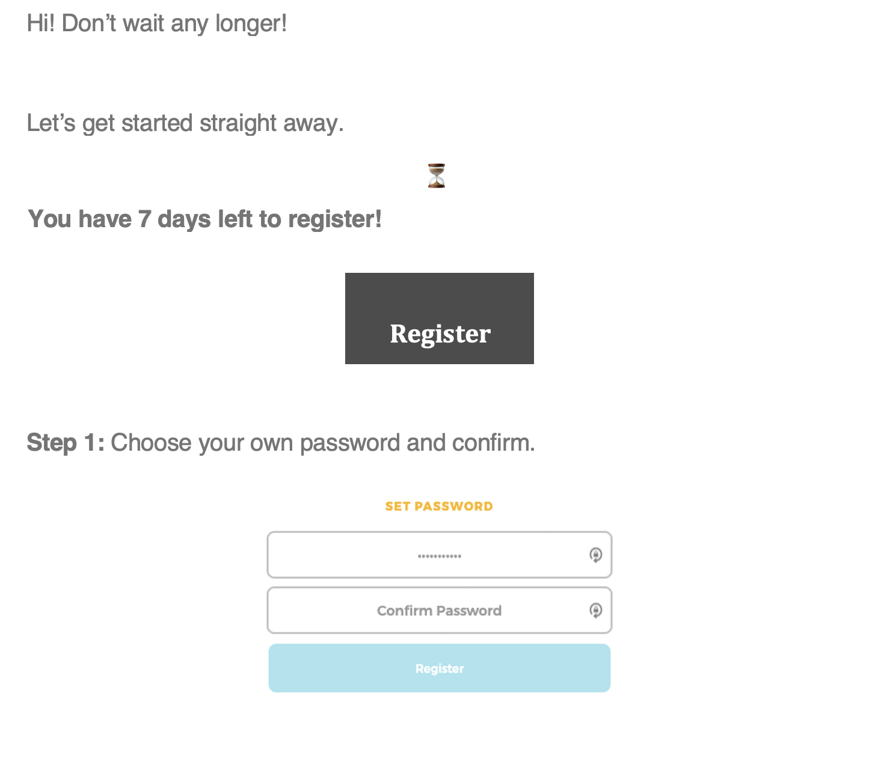
Registration email step 1

Slide 4
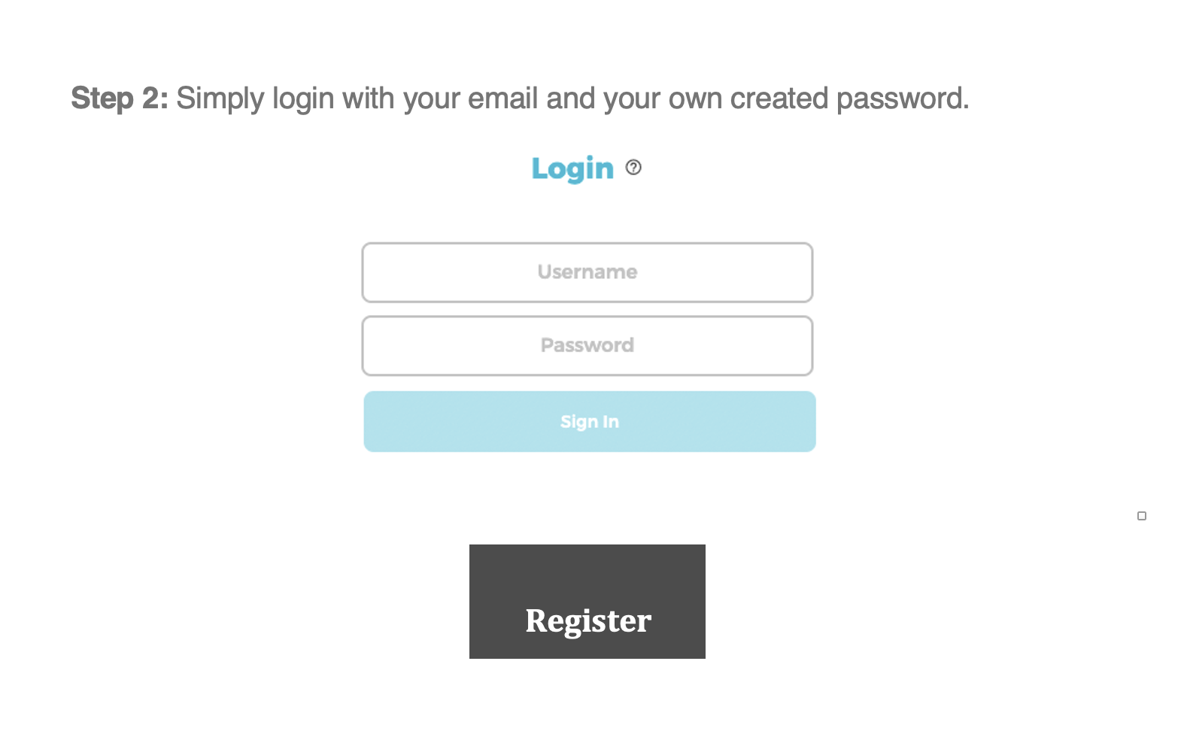
Registration email step 2

Slide 5
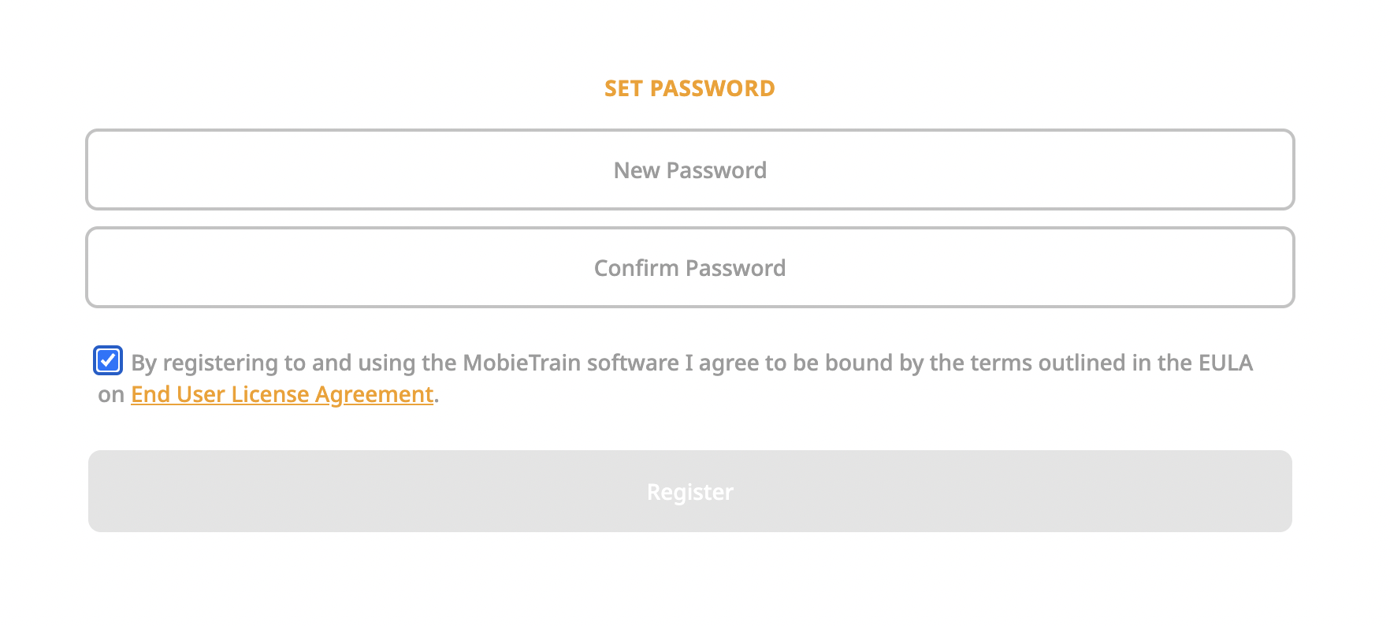
Choose your password

Slide 6
Choose your language

Slide 7
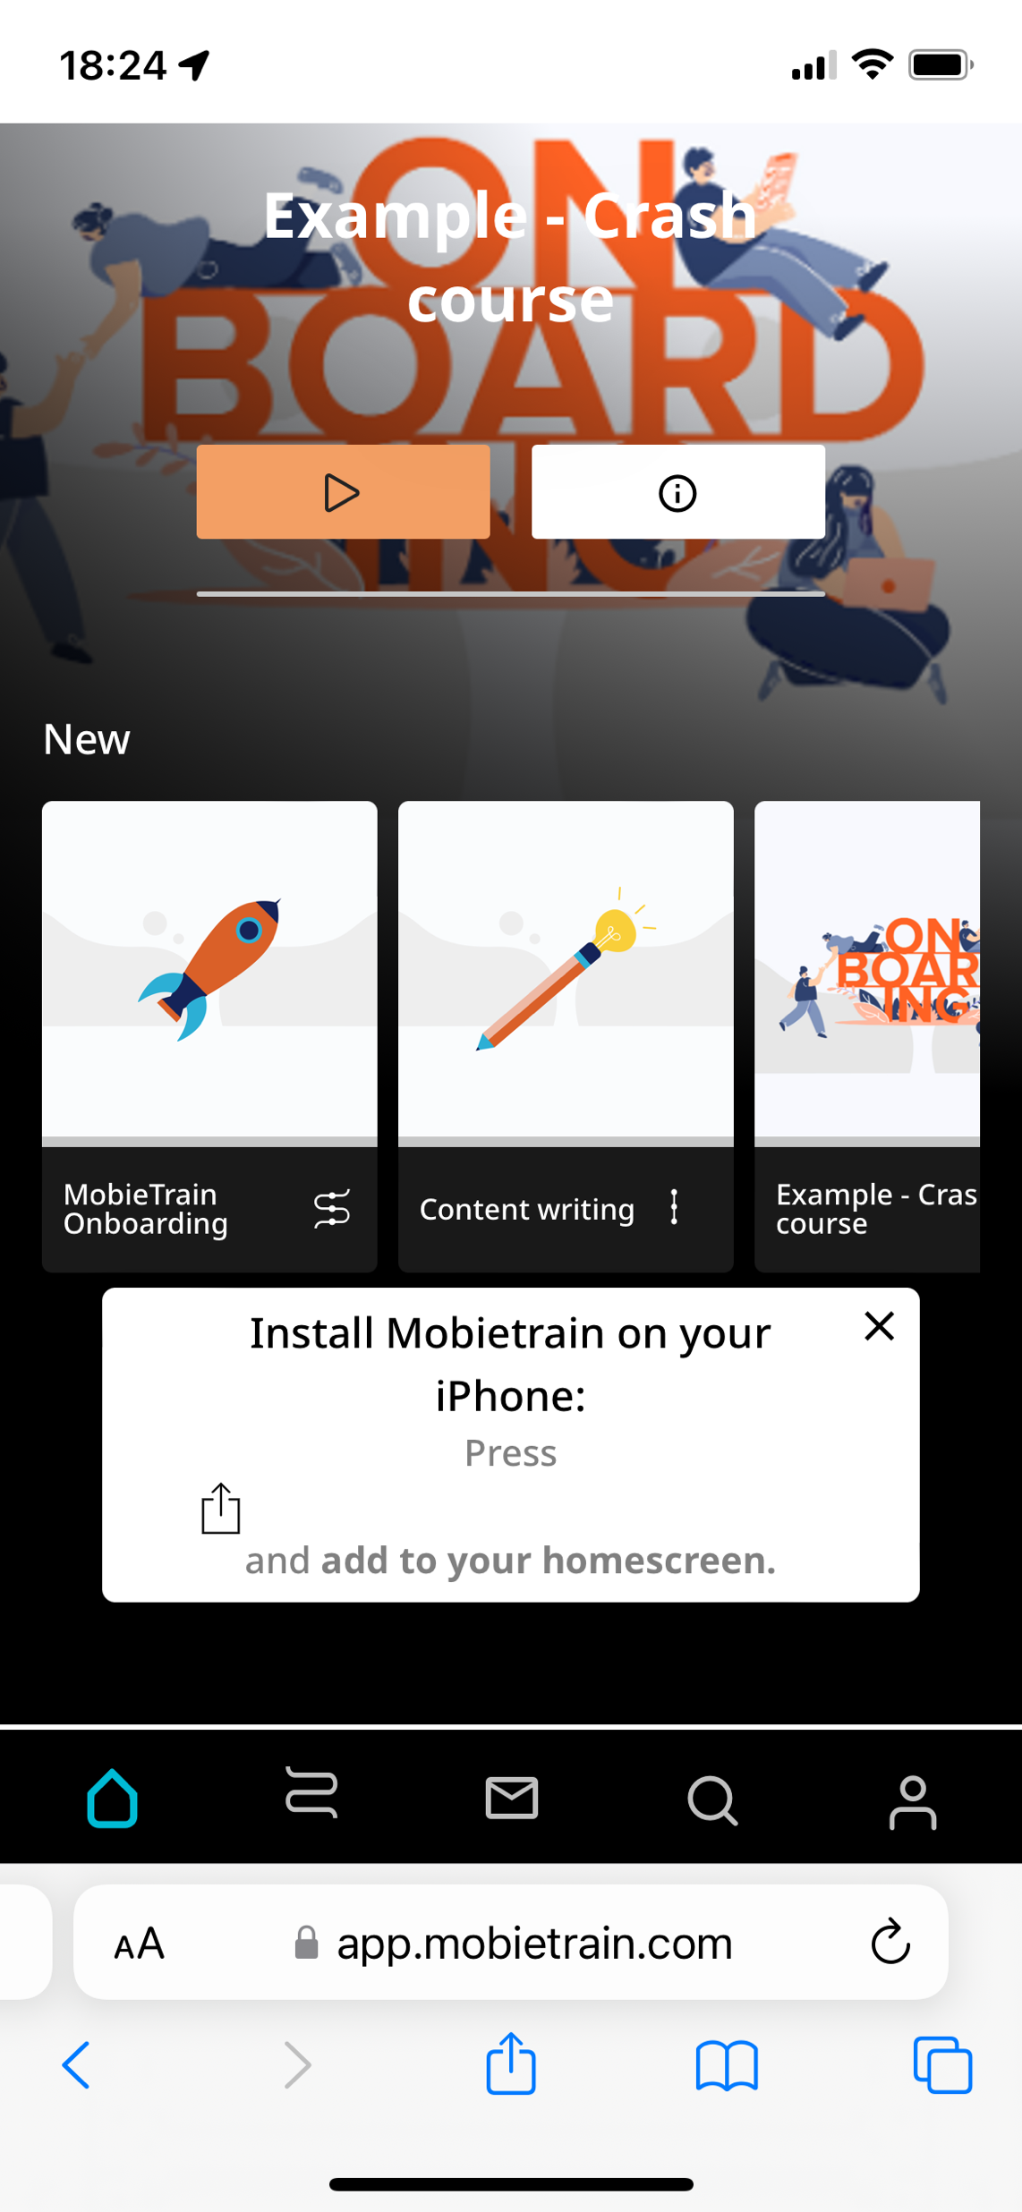
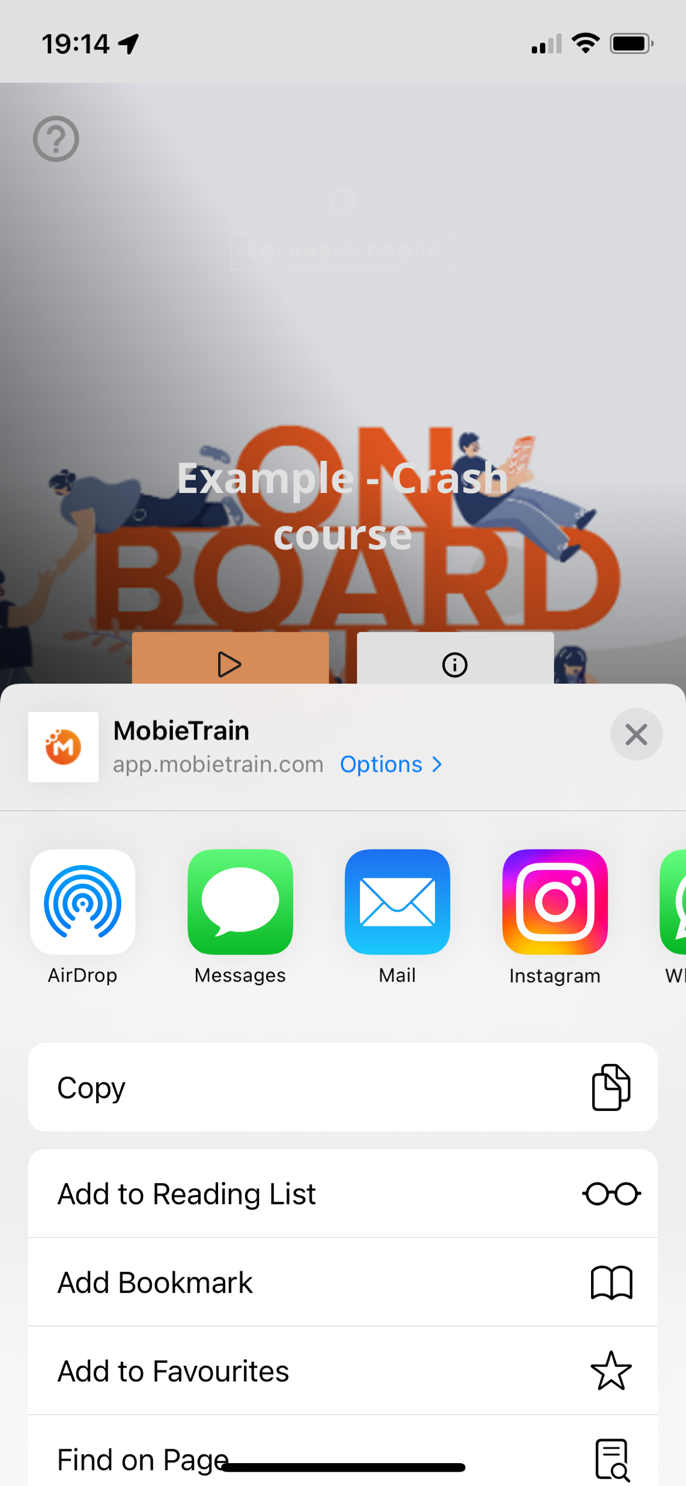
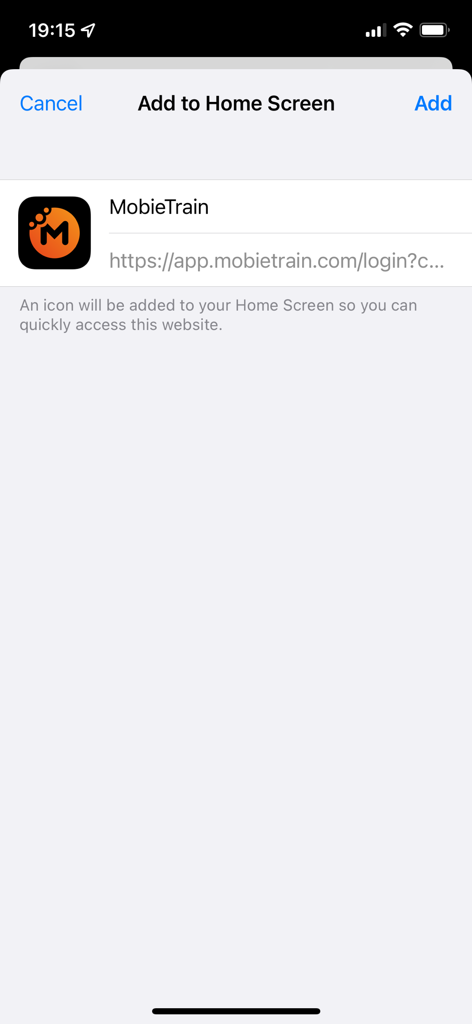
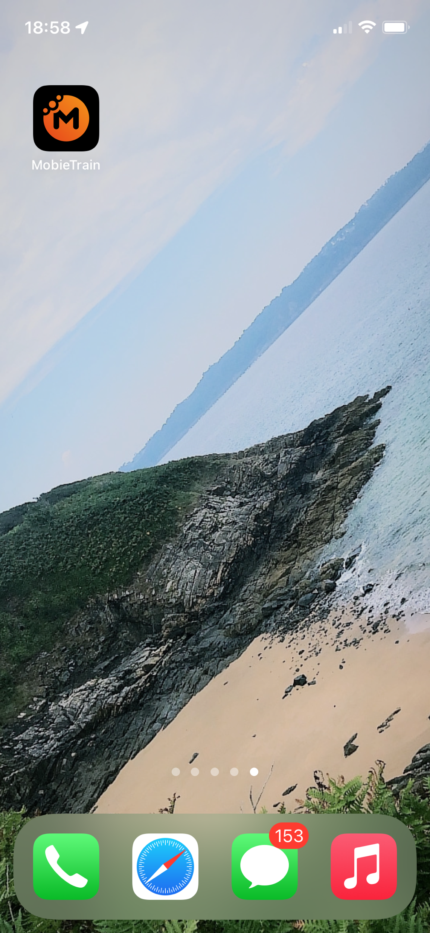
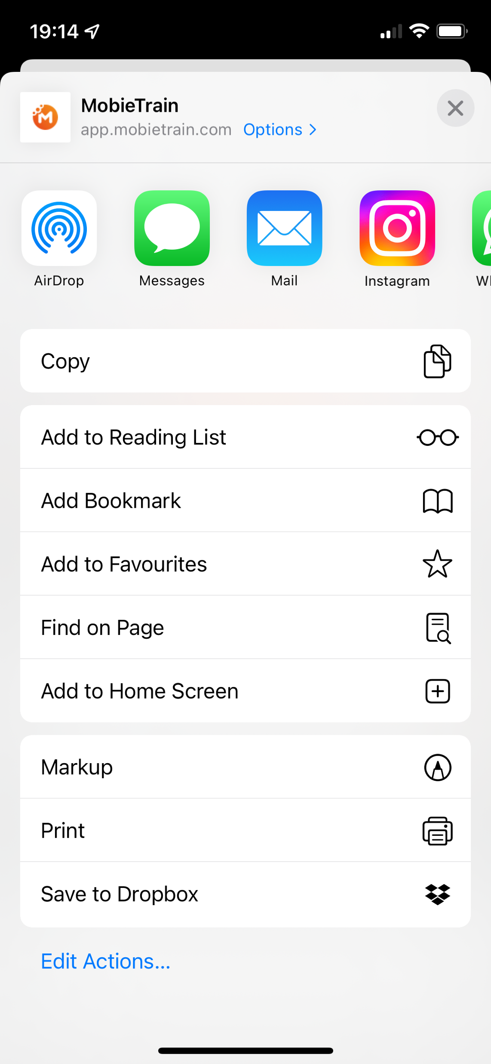
Add tab on the home screen of your iPhone
Open the browser and go to
https://app.mobietrain.com/

Slide 8
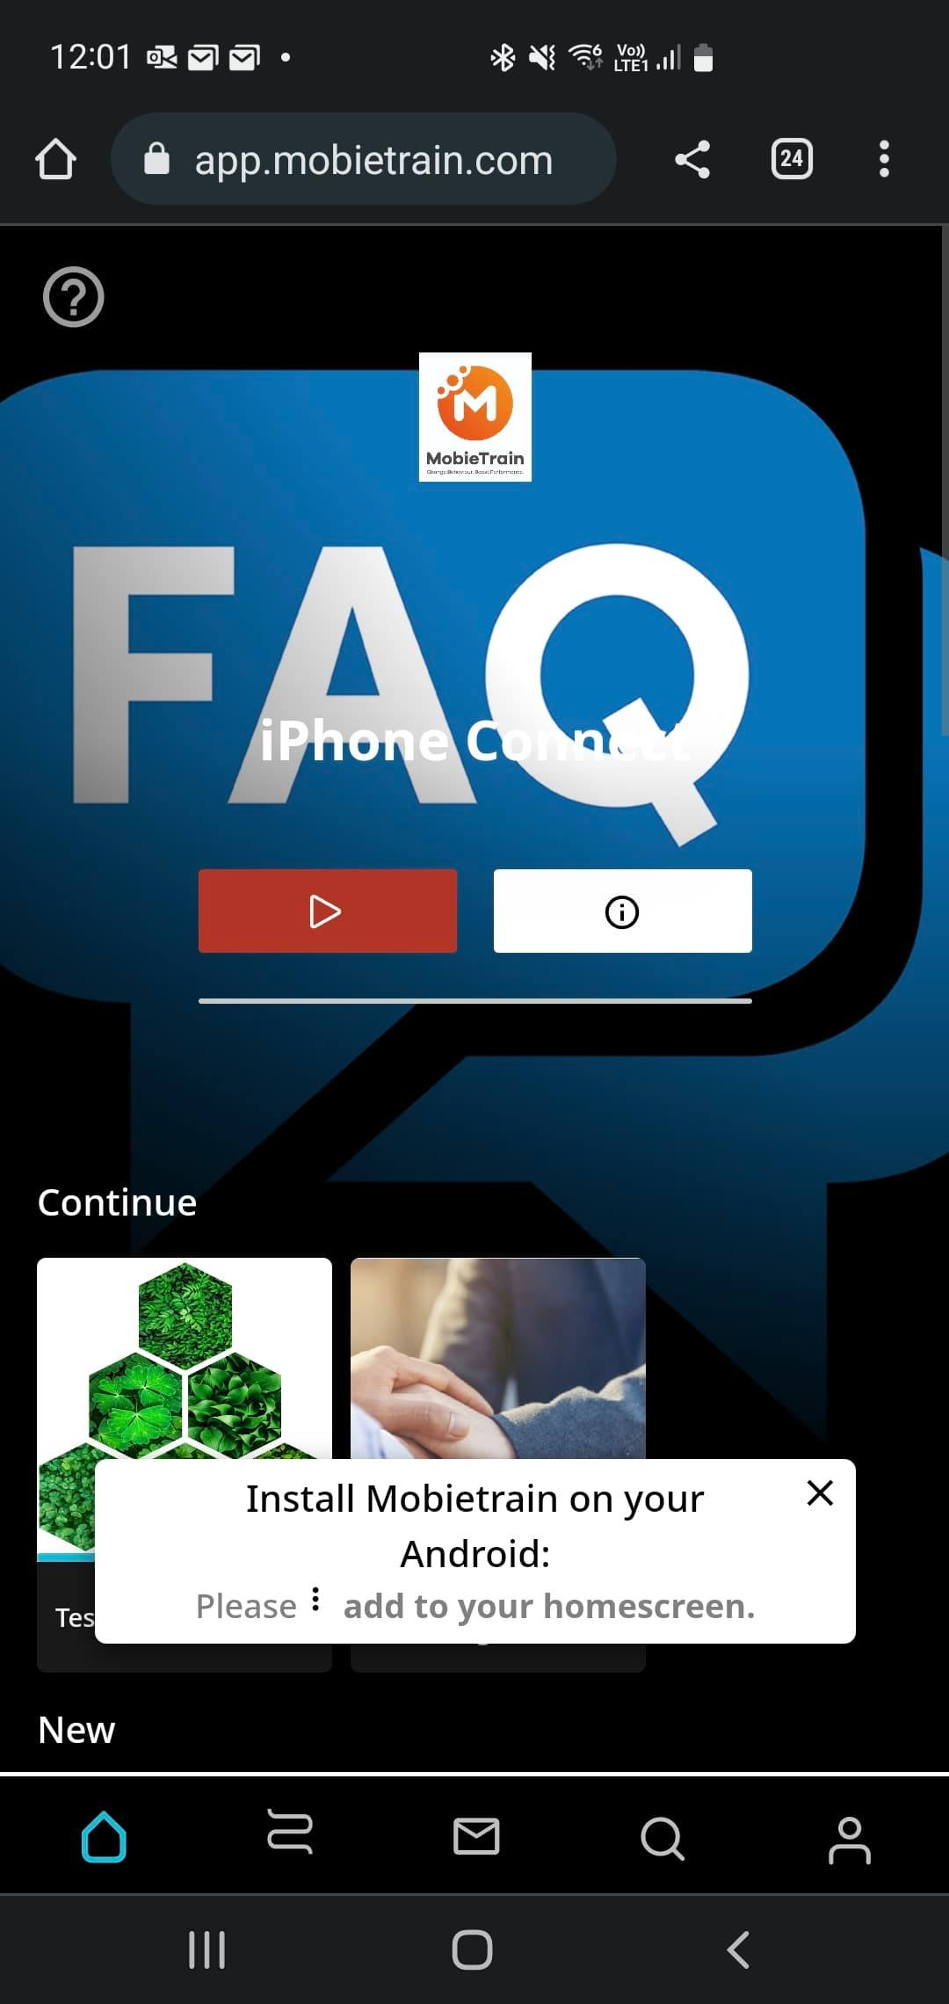
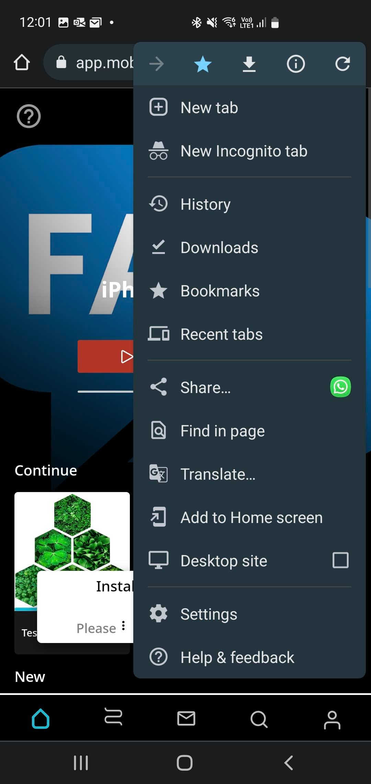
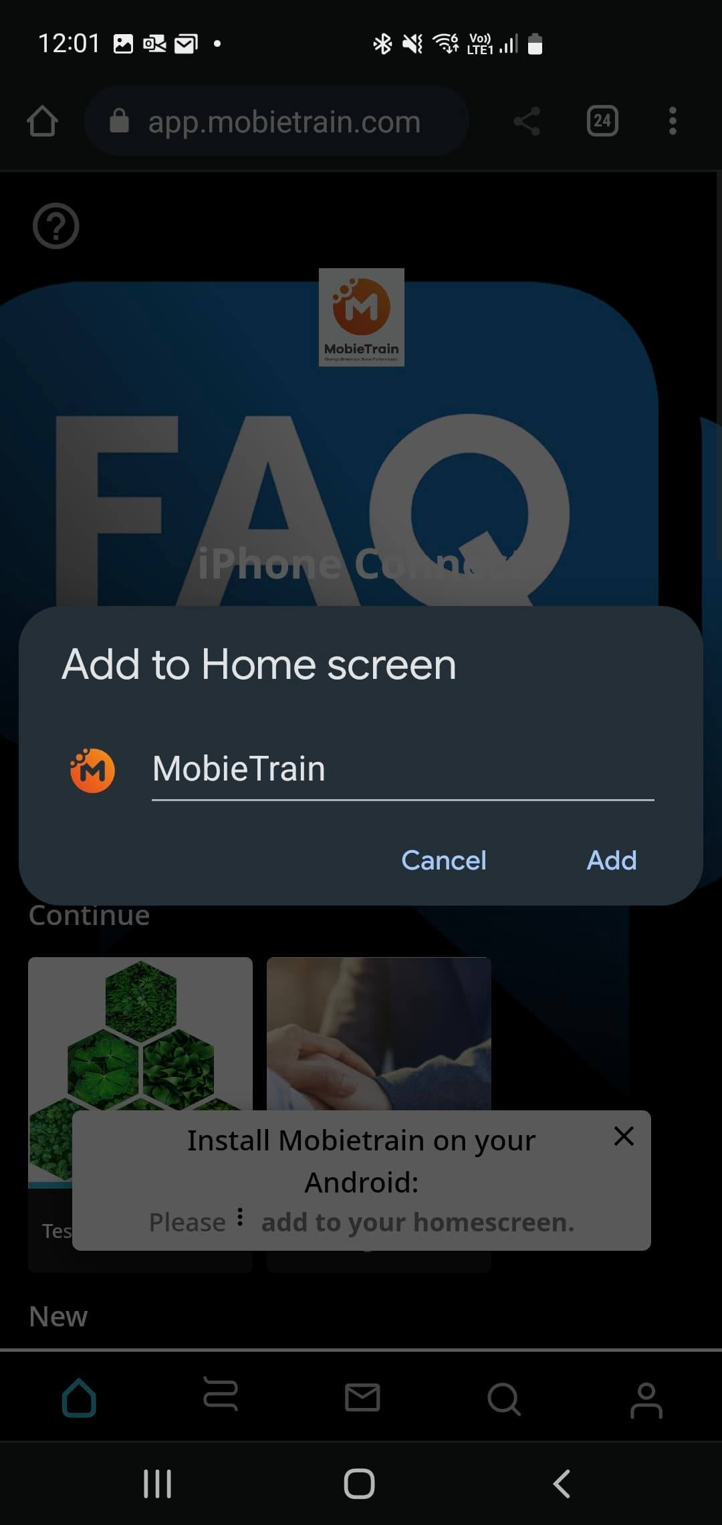
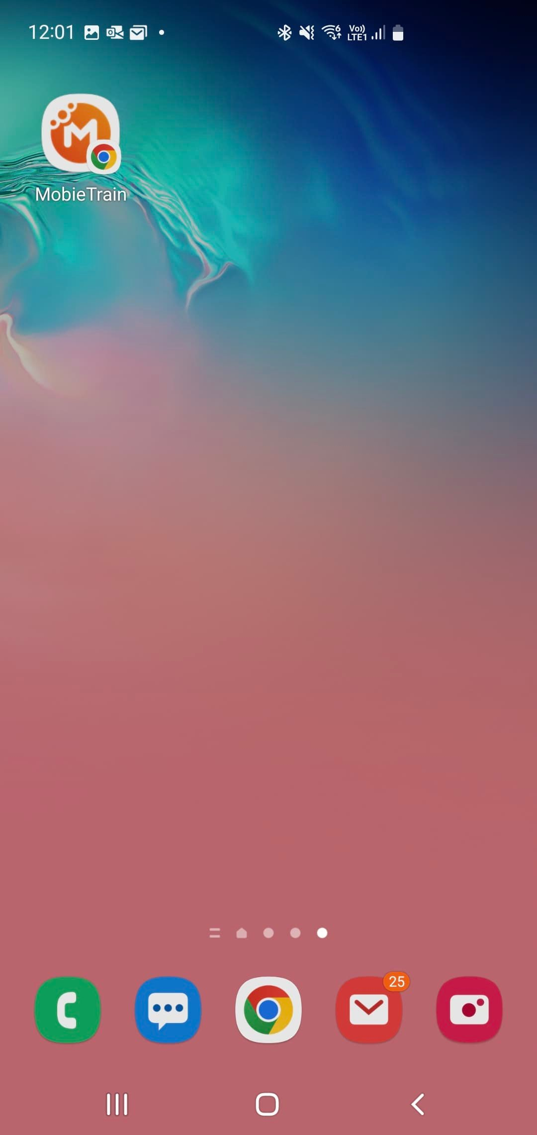
Add tab on the home screen of your Android phone
Open Google Chrome and go to
https://app.mobietrain.com/

Slide 9
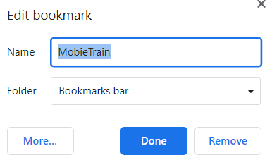
Bookmark MobieTrain on your desktop
Place the MobieTrain link on the desktop and add it to your favourites via "Bookmark this tab".
https://app.mobietrain.com/

Slide 10
Starting with MobieTrain
How to start?
Follow the successive screens that appear and click on next via the orange buttons
Important:
These buttons only appear the first time you log in
These buttons provide information on new elements such as a new type of question or a new learning moment.

Slide 11
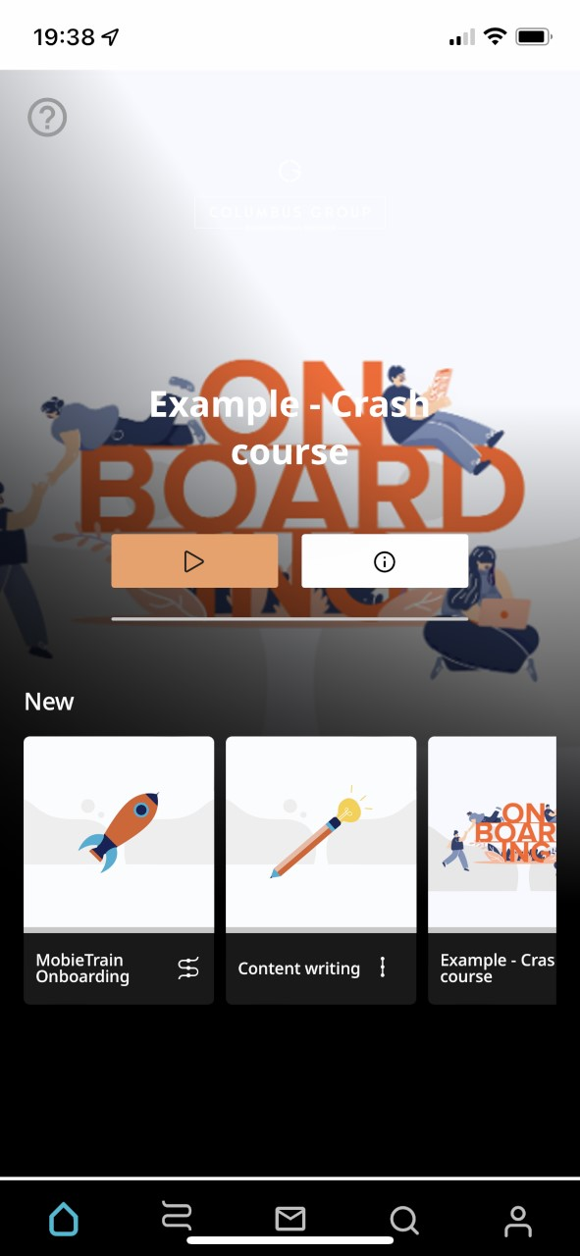
Homescreen
Homescreen
You will find the following on the homepage:
Here you will find all learning paths
Links to external locations
Planned events

Slide 12
Messages
Mailbox
The MobieTrain mailbox contains messages for you.
If there are new messages, a red circle will appear by the mailbox icon

Slide 13
Search function
Search function
You can use the search function to look for specific information from one of the learning paths.
Attention: this information only becomes visible the moment you have already completed this learning path.

Slide 14
Profile
Your profile
Through your profile, you have access to the following information:
progression: how many modules have I already completed and how many modules do I still need to complete for my next badge
badges : the badges you have obtained
settings : your name + language preference

