Slide 1


A glimpse…
into the mind of a content writer

Slide 2
Wellness & Wellbeing
What is your goal?
Why do you want to do this?
What will your approach be like?
What do you want to achieve?

Slide 3
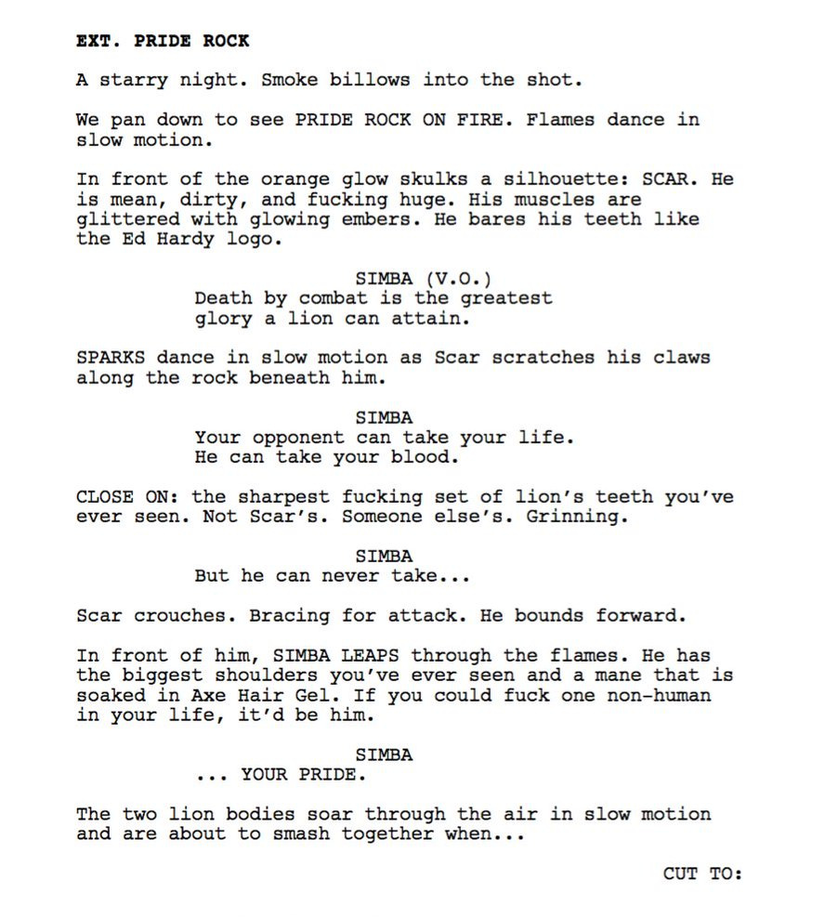
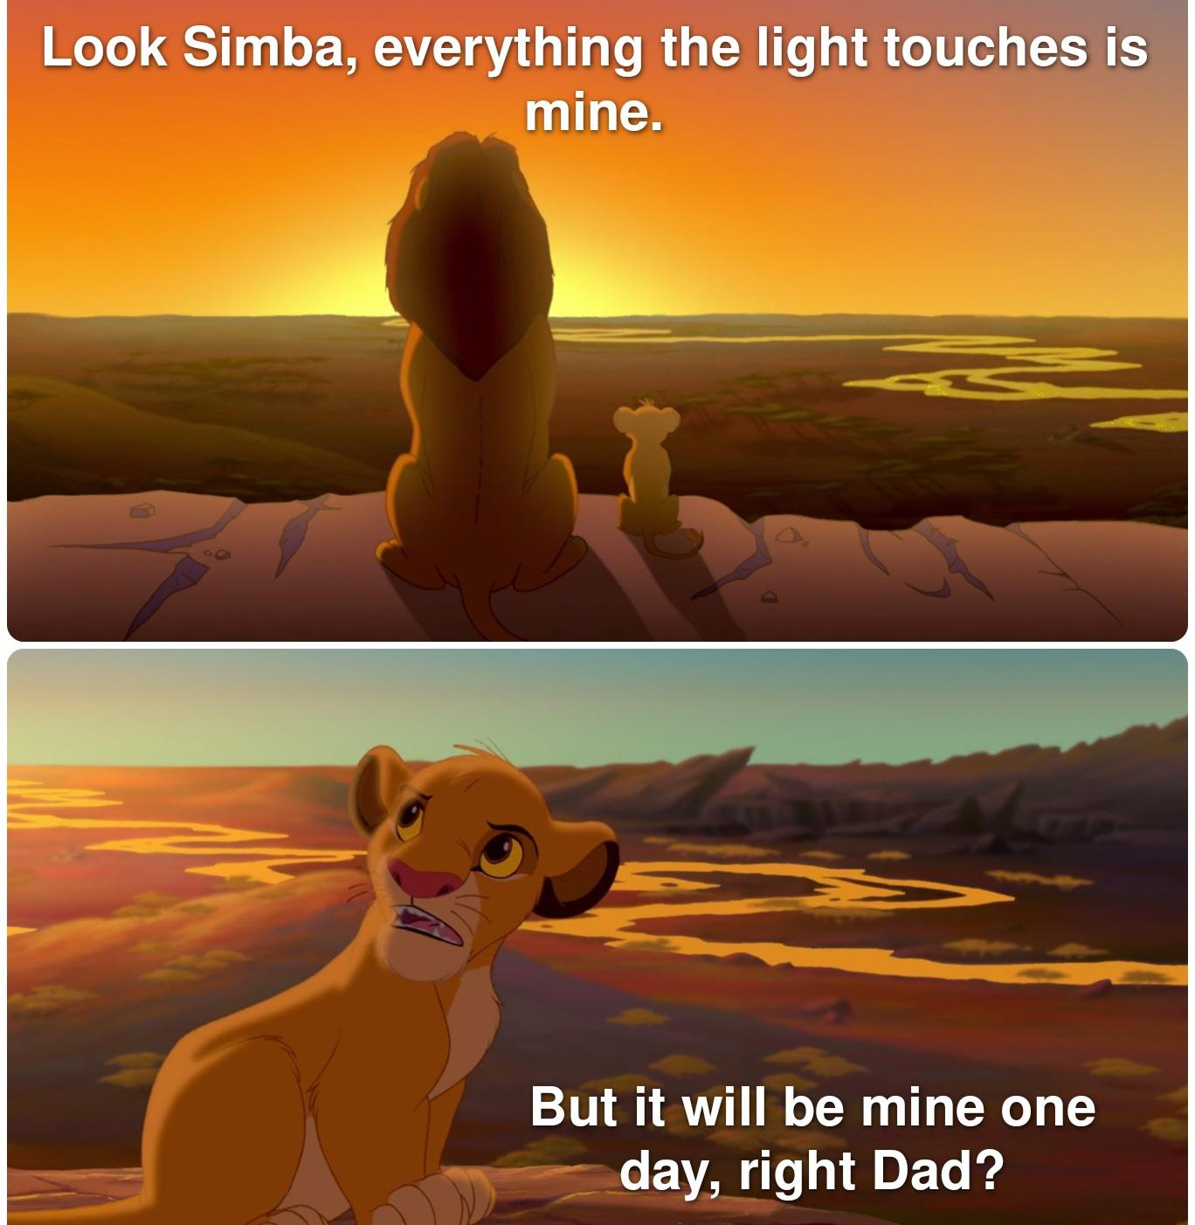

From the multiverse of the internet to your word document
After an initial search for content, you digest it all and summarise. How?

Slide 4




Brainstorm a structure
After you summarise, you apply a structure.
We all know the story of Simba, but did you know there’s a second movie that re-tells the story from the perspective of Timon & Pumba?

Slide 5
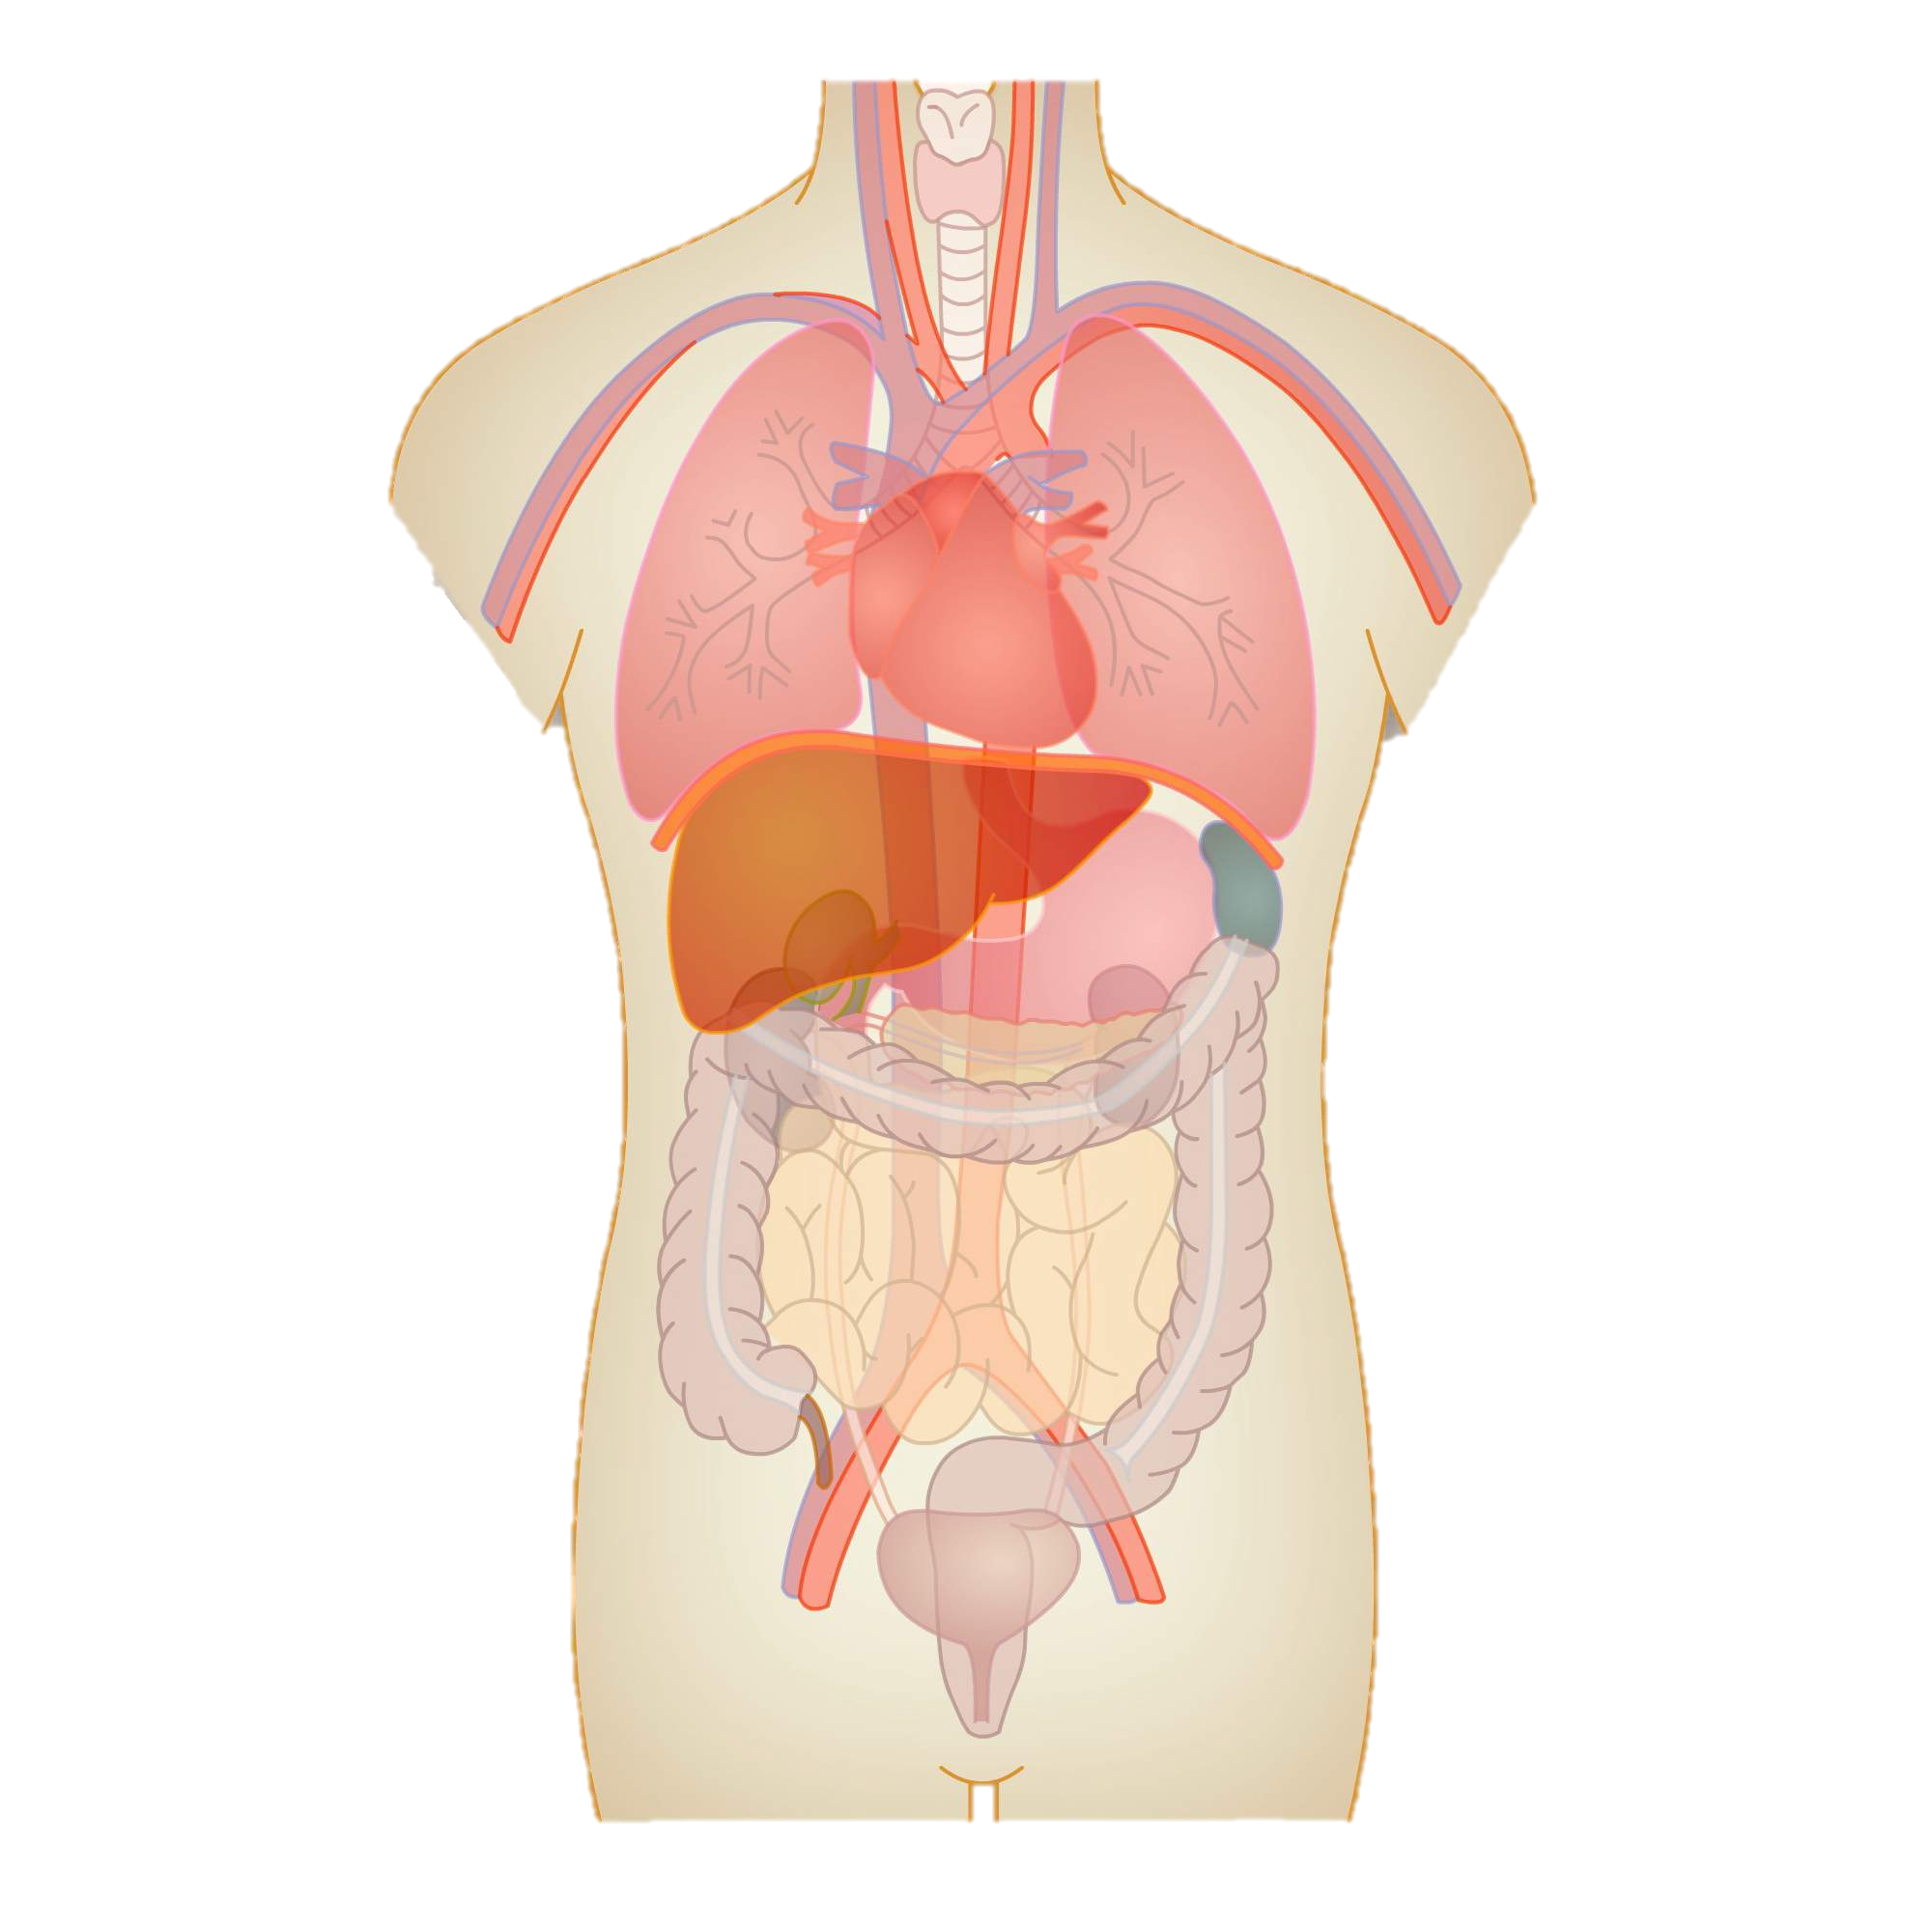

Classic path vs Crash course
Classic Path:
Are all your key subjects connected to each other, like parts of the human body?
Opt for the Classic Path and make up Topics.
Crash Course:
Can your key subjects be explained in a straight-forward way?

Slide 6
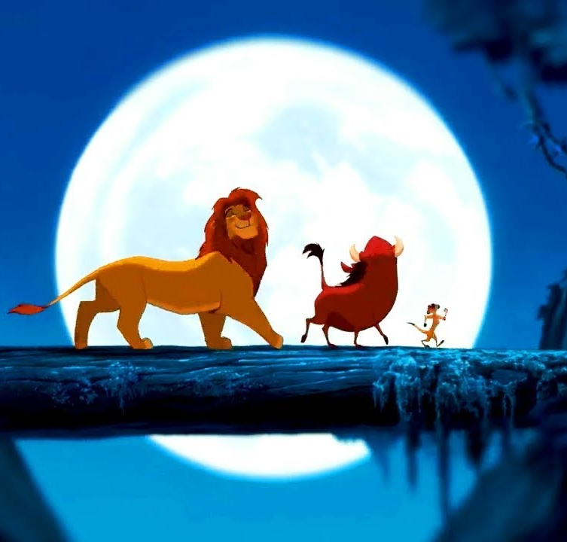
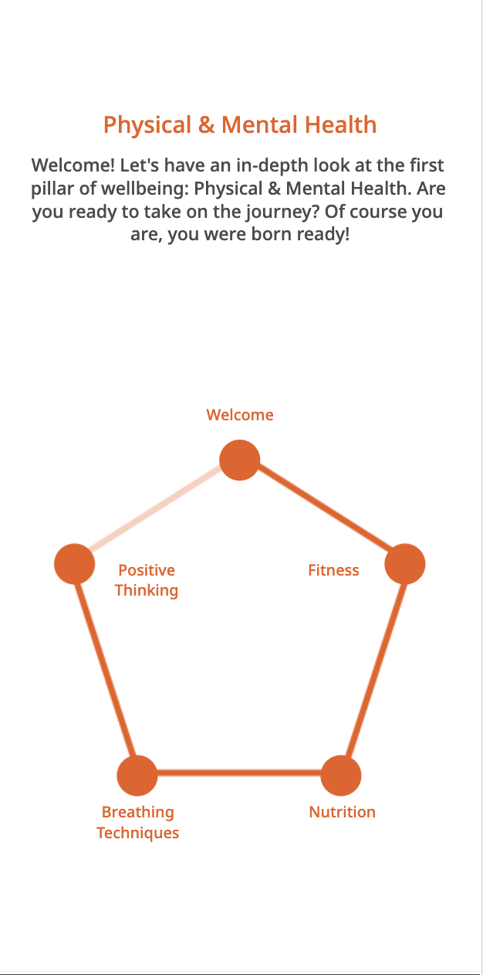
What does 1 LM look like?
Topic screen for Physical & Mental: how do you decide on your Learning Moments?

Slide 7
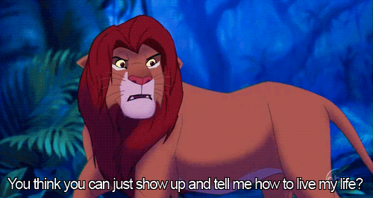
Get ‘em excited!
It is important to use words of encouragement and motivate employees.
What do you call your employees?
Bonus points for not calling it a training!

Slide 8


Greetings, folks!
FORMAL
CASUAL
Good evening ladies and gentleman
Hello there, nice to see you again
Welcome / Welcome back!
Nice to have you back!
Good to see you again, champ
Now, the moment you’ve been waiting for…
Hello there, my dude
And here it is
*drumruffel*
Hiya / Howdy!

Slide 9

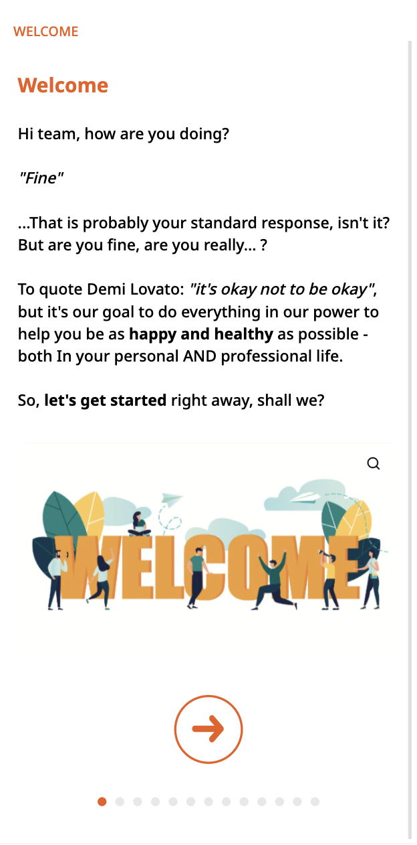
Introduction
Talk directly to your audience
Connect with your audience
Set a scene
Establish some common ground
When having a conversation, you ask questions, right? Not even training have to be 100% one-sided.
Would you attend his seminar? Didn’t think so.

Slide 10
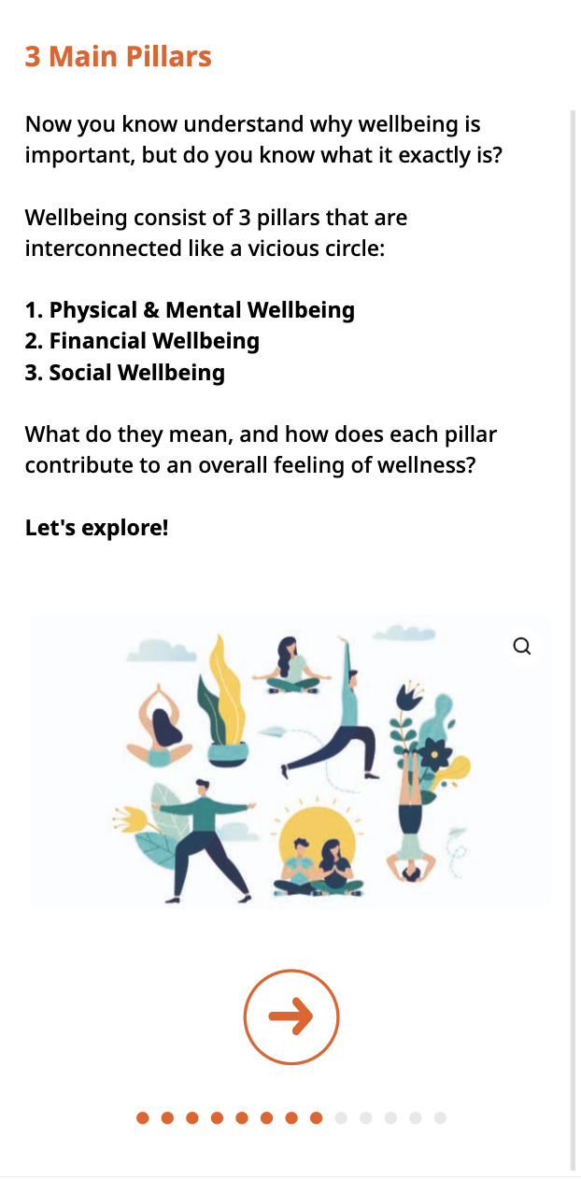
Provide an overview
Outline the adventure
Reader feels in control
Managing the expectations
You can also tease new things that are coming in the introduction or the conclusion!

Slide 11
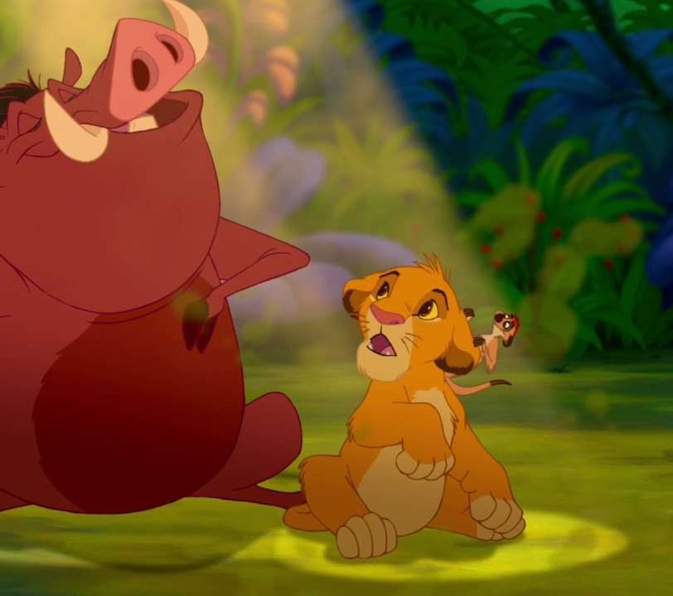
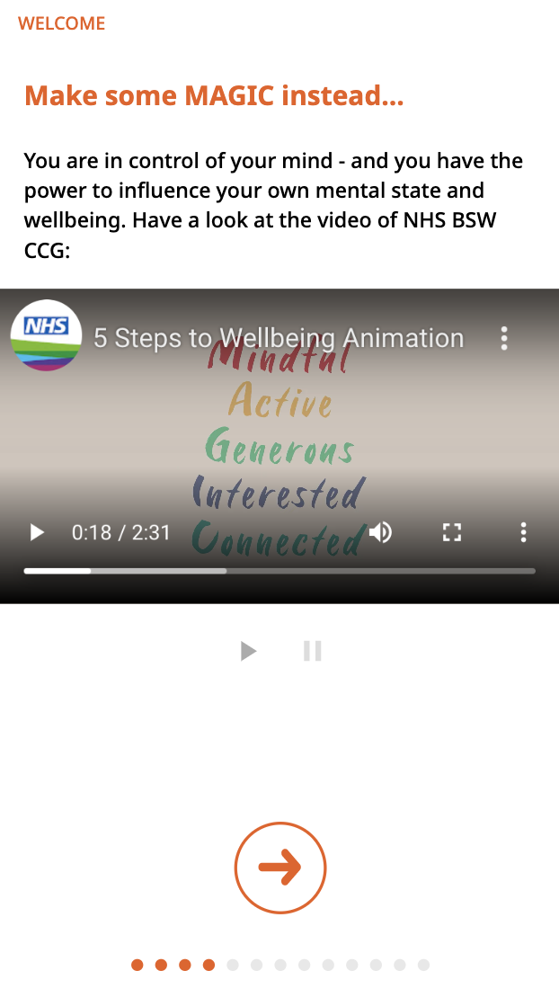

Multimedia content
It’s always a good idea to go visual.
In just a few minutes.
Don’t have time to go through 18 years of Simba’s life? Montage it in a song!
DON’T FEAR THE YOUTUBE
Searchfilter!

Slide 12

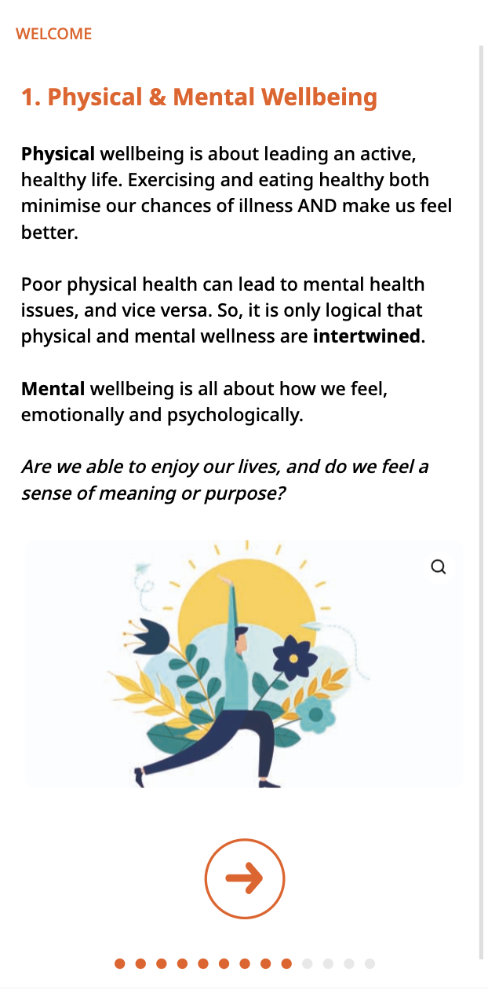
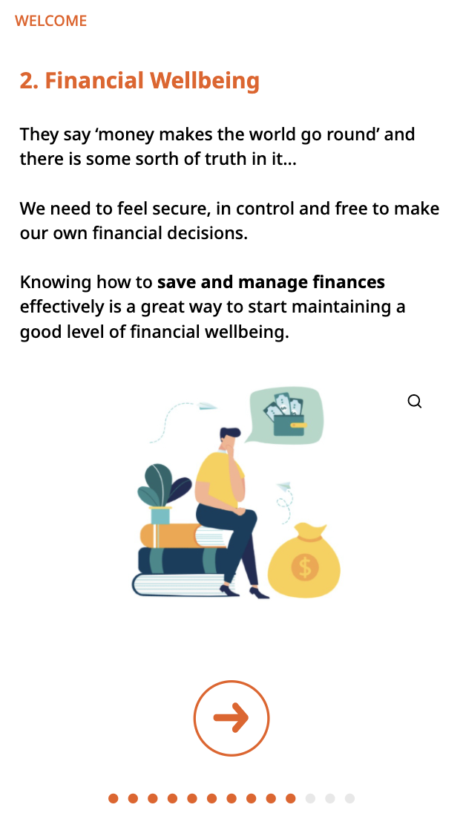
Get to the content
Structure into short sentences / paragraphs
Use bullet points and hit that space bar!
Lay-out is key!
Plane tickets = perfection
The back of a box of medication = horrible

Slide 13
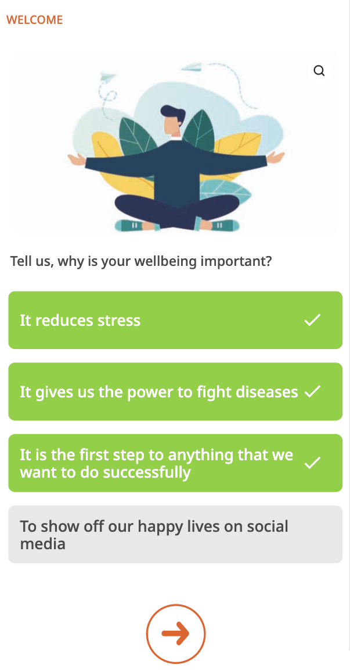
Questions are everything
Are they listening?
Questions cement knowledge by asking you to “retrieve” it.
Repeated testing maintains the focus!
We all think we’re sharing the bare bones when we tell a story – BUT ARE WE?

Slide 14

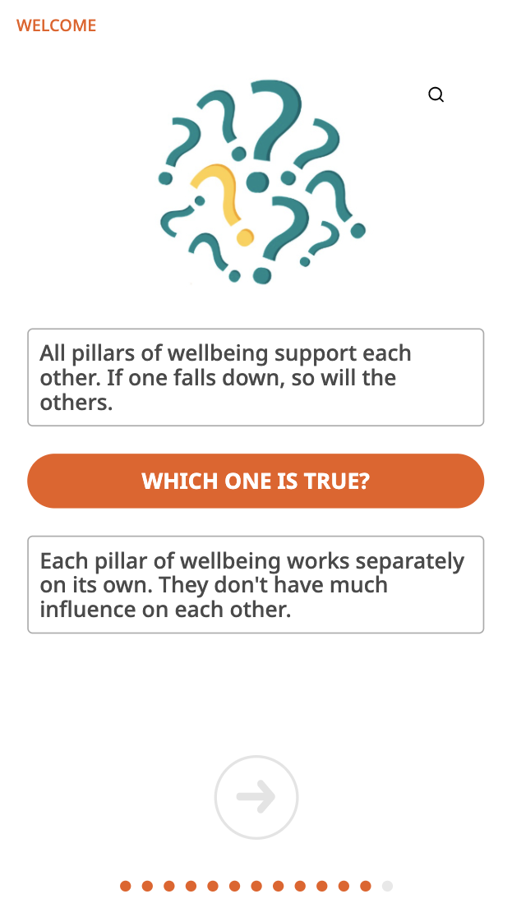
Ask more questions!
Let them remember!
Re-structure
Think of your training like a slinky. You can stretch it out, shrink it, but there’s always the same number of rings in it.

Slide 15
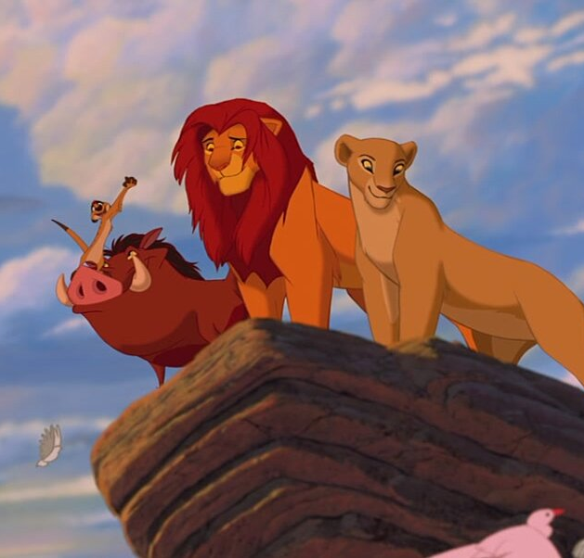
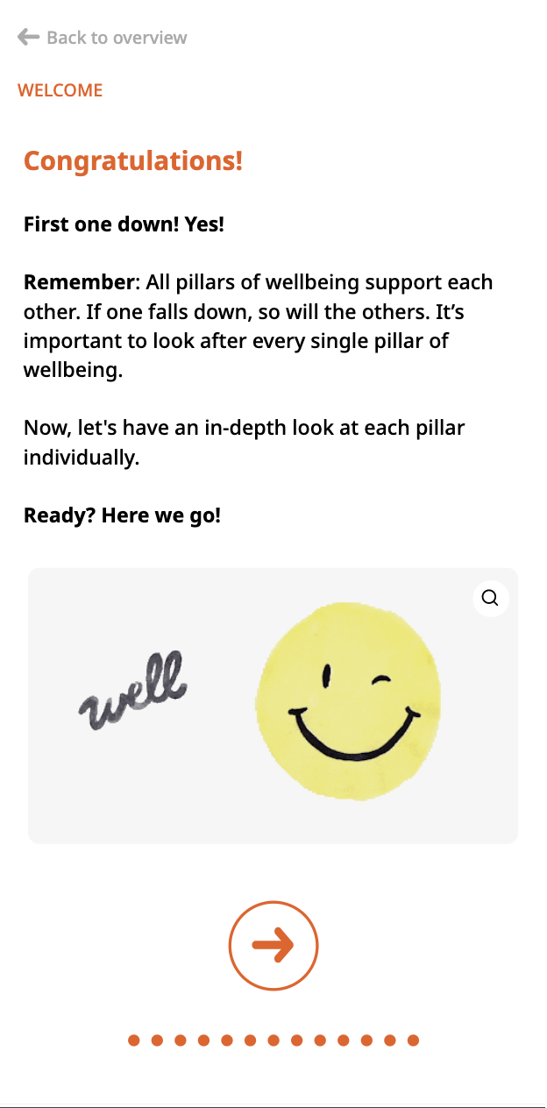
Give them some closure 🌈
Congratulations! Congrats! Victory!
Summary
Keep the overview in mind!

Slide 16
Let us give you some closure…
Have a clear goal in mind
Gather your content (text and visuals)
Digest the content and set up a logical structure
(crash course vs. classic learning path)
Decide on your tone of voice (formal or informal)
Let the writing process – a.k.a. fun – begin...
Introduction: Welcome + overview of what’s going to come
Share knowledge: keep it short and engaging
(use bullet points, GIFs, videos, ...)
Remember to ask questions (3 to 5 per LM)
Provide closure: Recap / Conclude

Slide 17


THANKS!
Any questions?
Victoria Cogorno
Content Writer @ MobieTrain
Viktoria Tarancova
Content Coordinator & Brand Ambassador @ MobieTrain
Noraleen Janssens
Content Writer @ MobieTrain

